Slide 1

EMPLOYEE ATTRITION
By Group 6-
Anindita Sarmah
Sanika Dhawale
Ariba Surani
Mayuri Jadhav

Slide 2

Agenda
Problem Statement
Project Proposal
Business Objective
Data source
Data Analysis
Data Cleaning and Preparing
Models used and interpretation
Conclusion

Slide 3

Problem Statement Employee Attrition Impact:
Increased workload
Decreased motivation
Loss of knowledge and skills
Increased recruitment costs
Negative impact on company culture

Slide 4

Project Proposal
Analyze the Employee Attrition factors for an organization
Model Building- Run different data analysis techniques on the dataset to find the most accurate one
Actionable Insights

Slide 5
Business Objective
HR Analysis tool for companies (especially those with large work)
Help companies to be prepared for future employee-loss
To find possible reasons for employee attrition

Slide 6

Data Source
The data for this project is found from kaggle.com Kaggle Dataset Link
Contains 1470 records and 35 columns

Slide 7
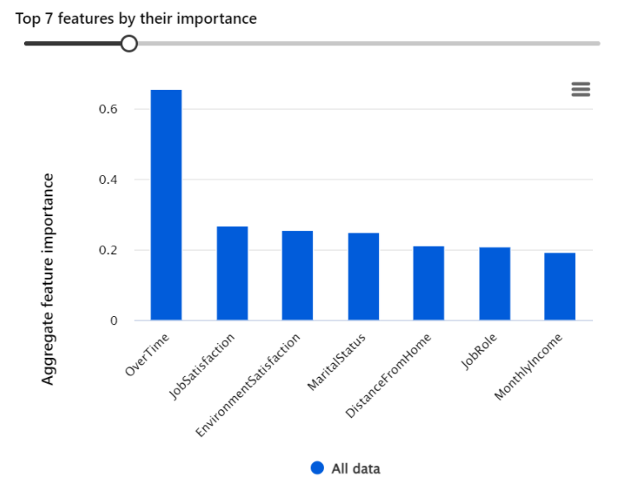
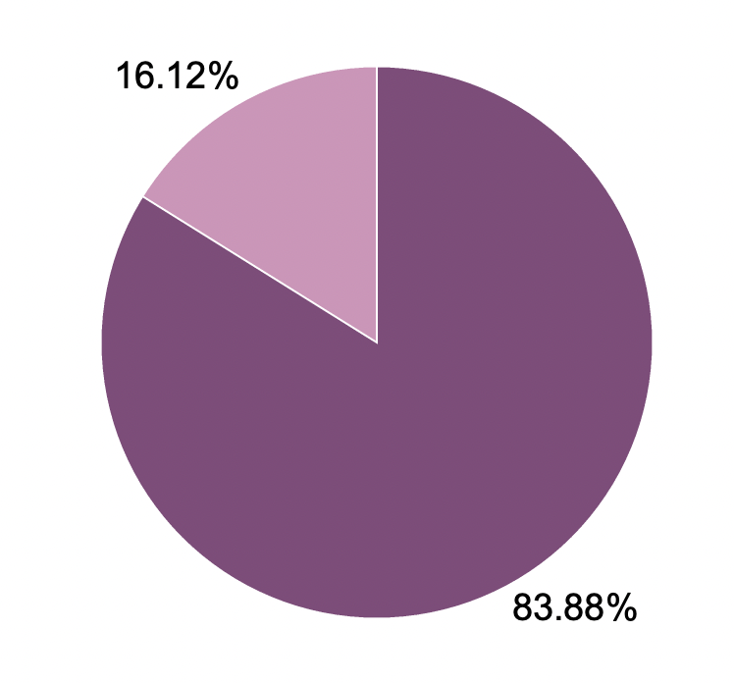

Data Analysis
Dependent Variable: Attrition
Independent Variable: 34 (Categorial: 19, Continuous: 15)

Slide 8
Data Cleaning and Preparing
No missing values
Deleted Columns: Over18, EducationField
Reason: Entire row having same value with no impact on variance
Columns changed: Over Time, Attrition
Reason: Conversion of String Data to Binary Data to run model through Heuristic lab

Slide 9
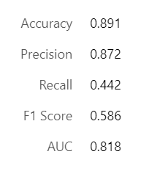
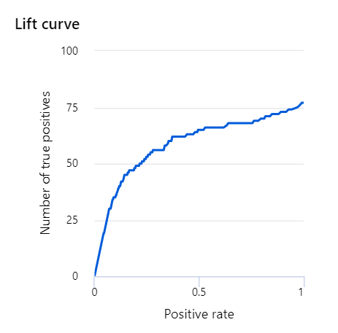
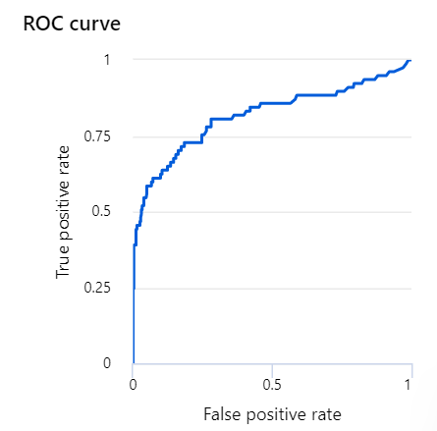
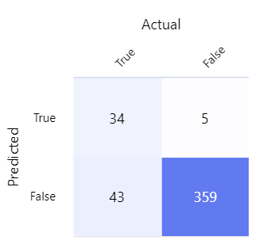
Logistic Regression

Slide 10
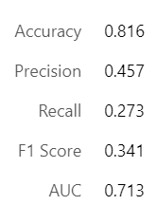
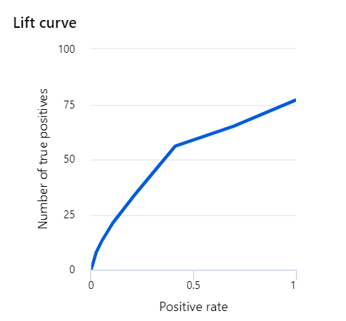
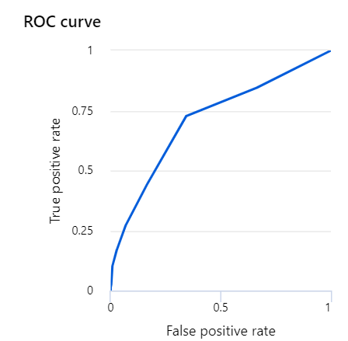
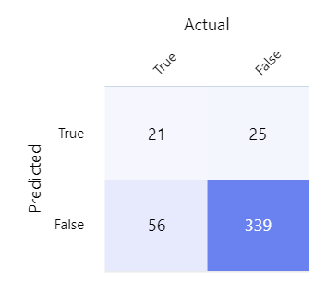
Decision Tree

Slide 11
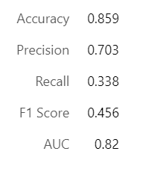
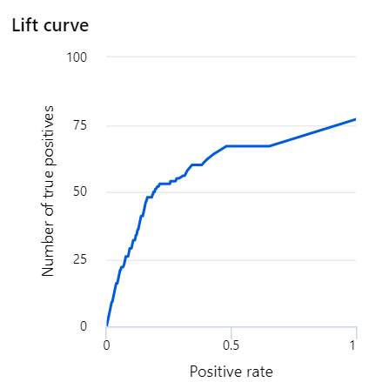
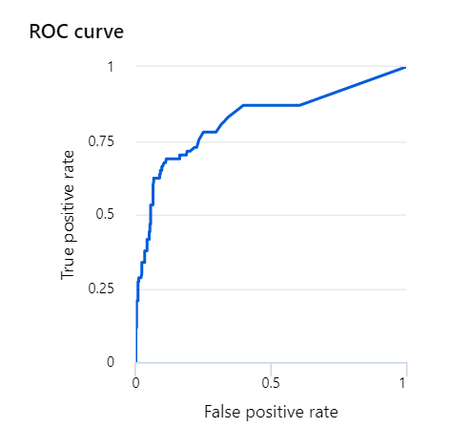
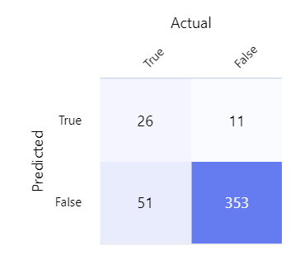
Boosted Decision Tree

Slide 12
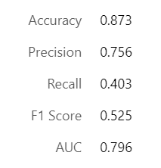
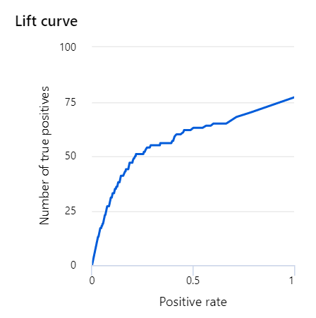
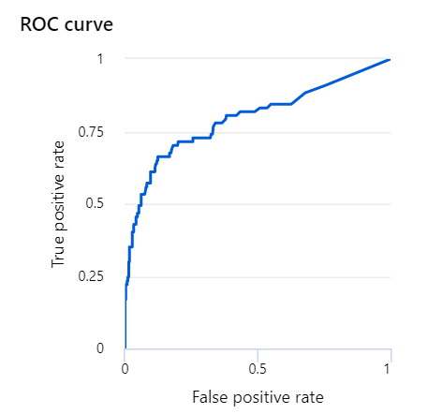
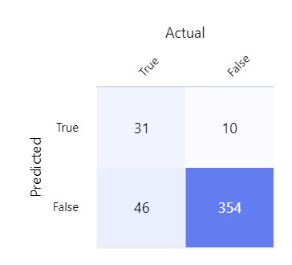
Neural Network

Slide 13
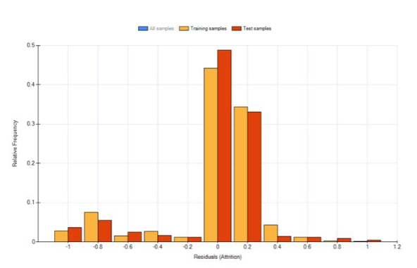
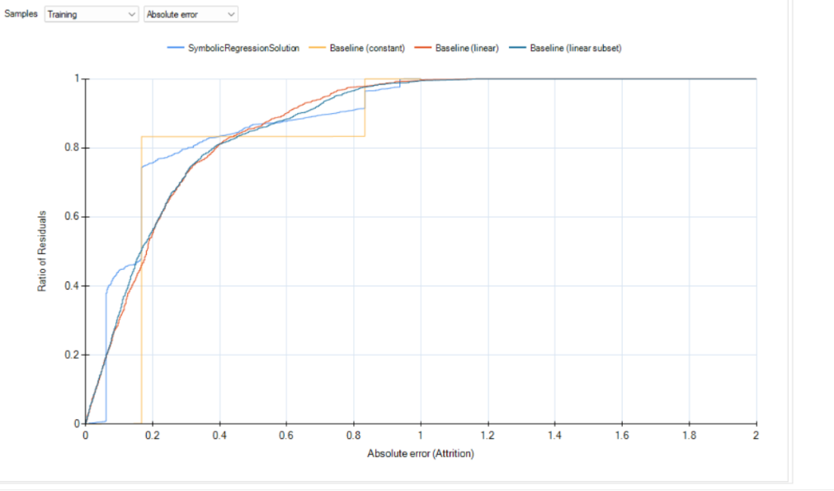
Genetic Algorithm
Pearson's R square = 0.045

Slide 14
Important Variables

Slide 15
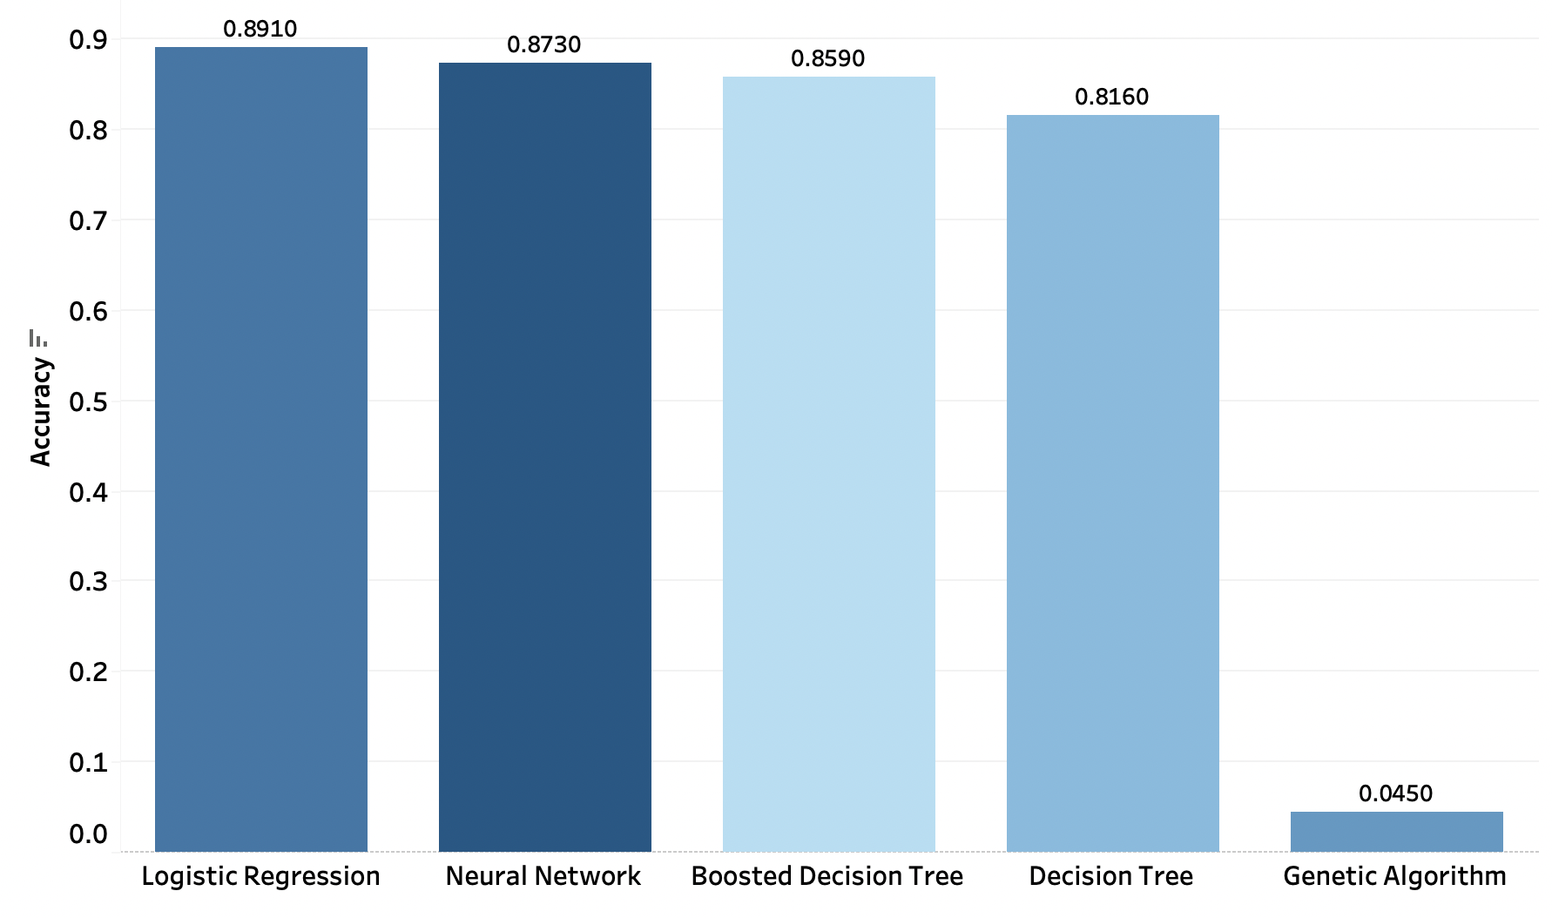
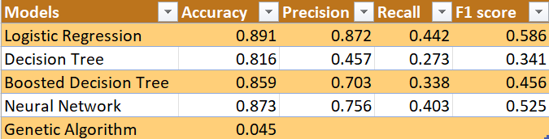
Model Comparison

Slide 16

Conclusion
Logistic Regression model has the highest accuracy out of all
Neural Network has the next highest accuracy, which is very close to Logistic Regression
But Neural Network has very low explainability, whereas Logistic Regression has decent explainability
Decision tree can help achieve better explainability but there is a trade-off with accuracy
Genetic Algorithm has the least accuracy
Hence Logistic Regression is the best suitable model for Employee Attribution problem

Slide 17
Recommendations and Insights
Increase allowance for employees to work overtime and make sure those who are working overtime are compensated fairly
Company should remember to appreciate employee's work using intrinsic and monetary factors
Fairly pay employee in same job level and job involvement with almost same income and stocks
Employer should treat everyone fairly and do not discriminate on basis of marital status

Slide 18

Thank You!
This Photo by Unknown author is licensed under CC BY-ND.

